Slide 1



PROJECT INTRODUCTION
Hospital Management System
A lightweight, browser-based platform that streamlines patient records, appointments, billing, and staff coordination — built entirely with front-end web technologies.
UNDER THE GUIDE OF:LALITHA VANI SREE MAM
Team Members = 2500030524 – MOHANA KRISHNA REDDY
2500030523 – GANESH CHOWDARY
2500031355 - LOVA SATYA KRISHNA

Slide 2




THE CHALLENGE
Problem Statement
Managing hospital data manually creates friction across every role — the system tackles are the core pain points.
Patient Data
Role-Based Access
Records for patients, doctors, appointments and billing live in disconnected sheets — slow to search, easy to lose, and hard to keep consistent.
Without clear permissions, staff and patients see the same screens — risking privacy, security, and confusion over responsibilities.
Manual billing, missed appointments, and duplicated effort waste hospital resources every single day.

Slide 3


WHAT WE AIM TO ACHIEVE
Project Objectives
01
02
03
04
Patient Info
Appointments
Payments
Resources
Store and retrieve complete patient profiles, medical history and contact details securely.
Let patients book, view and manage appointments with the right doctors in real time.
Generate and track bills and payments for consultations and services transparently.
Manage doctors, departments and hospital resources from a single admin dashboard.

Slide 4


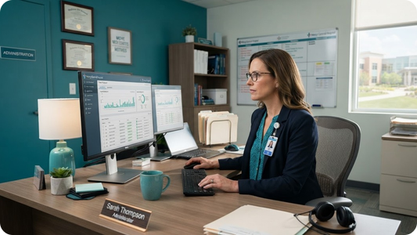
BUSINESS SYSTEM OVERVIEW
Three Roles, One System
Patients
Doctors
Administrators
Register, log in, book and view appointments, access medical records, and pay bills online.
View their schedules, manage patient appointments, update diagnoses and treatment notes.
Oversee users, doctors and departments, manage resources, and monitor overall operations.

Slide 5




SYSTEM MODULES
Modules Breakdown
Patient Module
Doctor Module
Admin Module
Register & secure login
Book and cancel appointments
View medical history
Make and track payments
Update personal profile
View daily schedule
Approve or reschedule visits
Access patient records
Add diagnosis & notes
Track appointment status
Manage all users
Add & assign doctors
Oversee departments
Monitor payments
Control system resources

Slide 6


APPLICATION NAVIGATION
From Login to Role Dashboards
Home Page
Authentication
Role Routing
Role-specific functions
Login or register and choose your role.
Credentials validated against stored users.
Users sent to the right dashboard by role.
Every screen a user reaches depends on the role stored at login — keeping data private and interfaces focused.

Slide 7




INSIDE THE MODULES
Module Details
Patient Processes
Doctor Capabilities
Admin Management
Patients create an account, browse available doctors and departments, request appointments, and receive confirmations. They review past visits, download reports, and settle bills through the payments screen.
Doctors log in to a personalized dashboard showing their upcoming appointments. They accept or reschedule requests, open patient records, record diagnoses and prescriptions, and mark visits as complete.
Administrators add and remove doctors, assign them to departments, manage patient accounts, and monitor all appointments and payments across the hospital from one control center.

Slide 8


DEMO & CONCLUSION
See It in Action
Demo Order
Why It Matters
1. Register a new patient account
2. Log in and book an appointment
3. Doctor confirms & adds notes
4. Patient completes a payment
5. Admin reviews users & reports
Centralized, always-available records
Secure, role-based access for all
Faster appointments & billing
Zero backend — easy to deploy
A clean base ready to scale

Slide 9

TECHNOLOGIES & UI DESIGN
Accessing Browser
DEMO
1. Open Home Page
2. Patient Login → Book Appointment → Payment
3. Doctor Login → Schedule → Medical History → Prescriptions
4. Admin Login → Manage → Resources → Staff Schedule
.

Slide 10

TECHNICAL IMPLEMENTATION
Admin Module
Manage Doctor
Displays doctor records.
Resource Allocation
Shows beds, ICU beds, ventilators and operation rooms.
Manage Patients
Displays patient records.
View Appointment
Displays scheduled consultations.

Slide 11
TECHNICAL IMPLEMENTATION
Doctor Module
Consultation
Doctor can view the consultation schedule.
.
Support
This module supports doctor-side consultation management.
Patient Diagnosis
Medical History shows patient diagnosis, allergies and previous treatment.
Medicine
Prescription Management shows medicine, dosage, duration and instructions.

Slide 12
TECHNICAL IMPLEMENTATION
Patient Module
Patient Details
Patient enters name, ID and phone number.
Patient Selection
Patient selects an existing doctor.
Patient Visit
Patient provides the reason for the visit.
Information
Appointment
Appointment information is stored using Local Storage.
Patient selects appointment date and time.

Slide 13

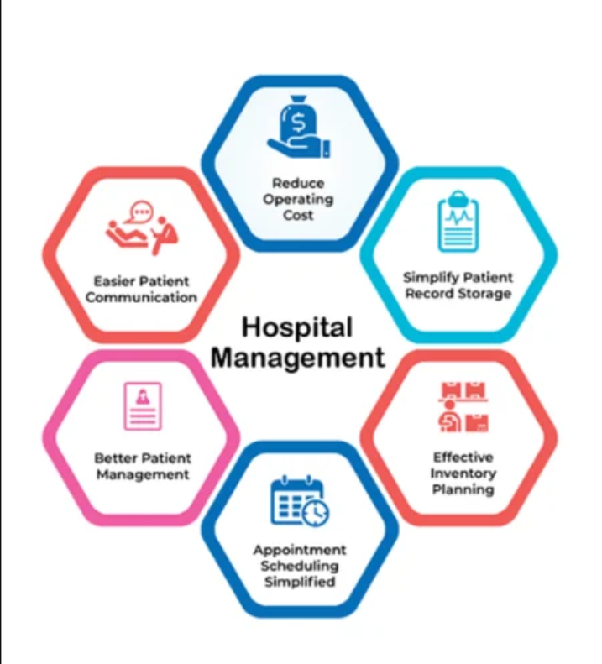
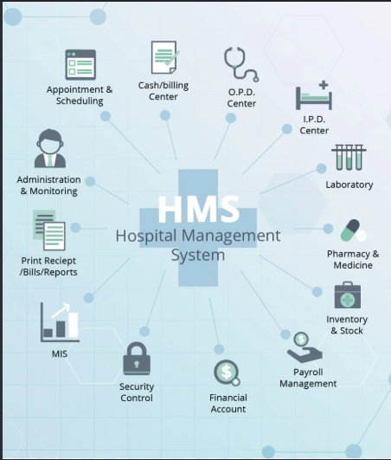

Slide 14

THANK YOU

